Slide 1

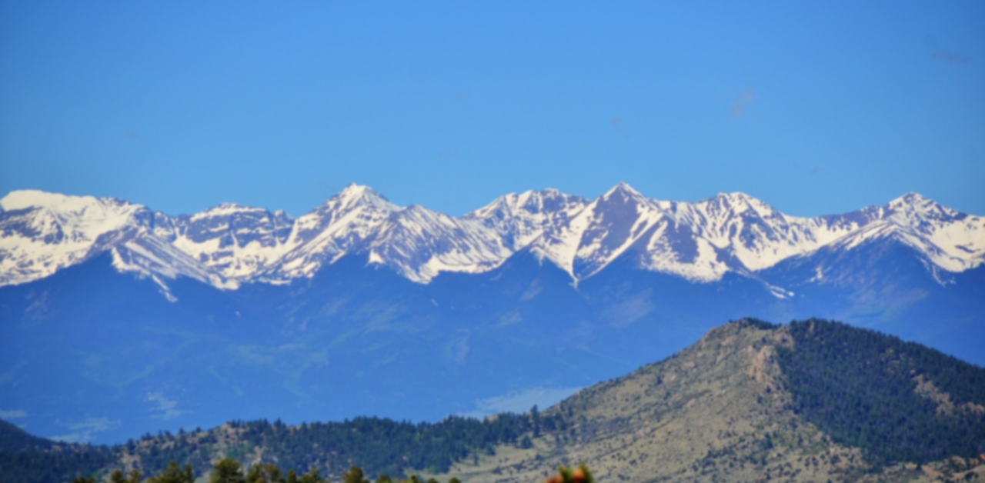
BASIC OVERVIEW
Saranoma Crater National Park
Oregon
Saranoma Highlands
Located in the Saranoma Highlands
  Mountainous area in Eastern Oregon
  Filled with Forests
Large attraction in Saranoma County
Run by the National Park Service
Surrounding area facilitated by the U.S. Forest Service
Became a National Park in 1921

Slide 2
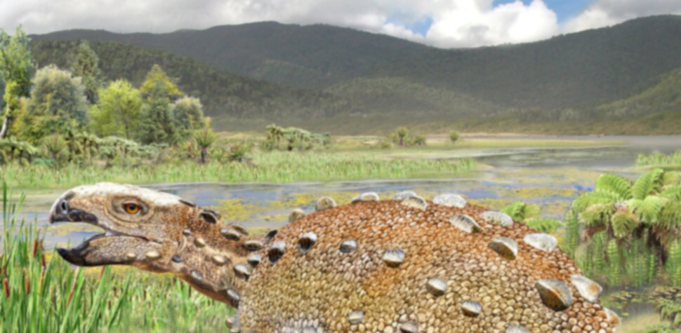
PRE-HISTORY
Saranoma Crater National Park
Oregon
Crater Formation
Theory #1 – Celestial Impact Theory
  The crater was formed by a large celestial during the late Permian period.
  Likely Untrue
Theory #2 – Caldera Theory
  The crater is a Caldera formed by a massive super volcano
  Possibly True, little evidence
Theory #3 – Crust Anomaly Theory
  An anomaly in the earths crust caused the crust to crack in a perfect circle and form the crater after millions of years of expansion
  Also possible, some evidence, can not be confirmed
Notes:
Theory #1
There has been no celestial body found
Lava tunnels tell another story about its formation
First theory about the craters formation
Some relate this to the Great extinction, also unlikely
Theory #2
Possible, area is clearly volcanic
Many lava tubes travel to the three volcanic mountains on the craters ridge
No lava chamber has been located
Theory #3
Possible, Cust formation shows anomalies around this area
Unknown why this would happen if it’s true

Slide 3
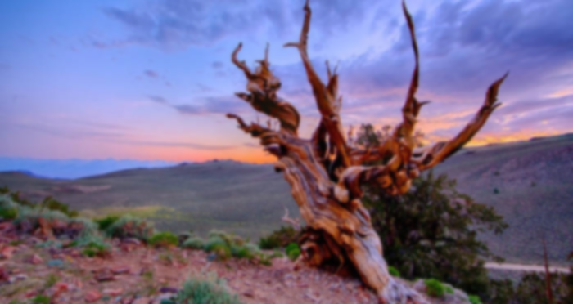
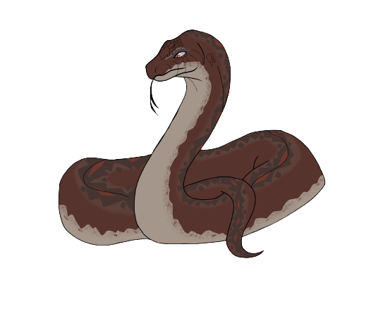
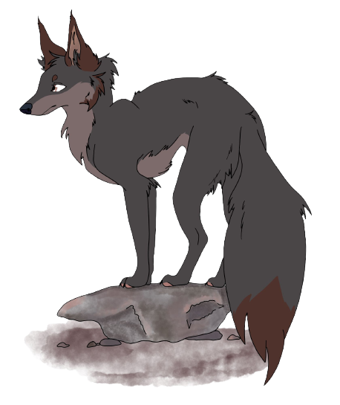

PRE-HISTORY
Saranoma Crater National Park
Oregon
Animal Evolution
Park is home to many unique species of Animals
  Ghost Bison
  Stone Fox
  Root Snake
Animals Entered by crossing over low parts of the crater and were trapped inside
  Craters pass was formed 500,000 years ago
Isolation facilitated unique evolutionary features
Saranoma Root Snake
Stone Fox
Saranoma Crater Ghost Bison
Notes:
Evolution:
Ghost Bison
Smaller, shorter legs since they are no longer migratory
Warmer for the colder weather in crater, tend to steam off snow
Stone Fox
Evolved to blend in with higher level rock colors
Coat changes color depending on location in crater
Root Snake
Evolved to blend in with Methuselah Tree roots
Wraps around tree roots and waits for prey

Slide 4
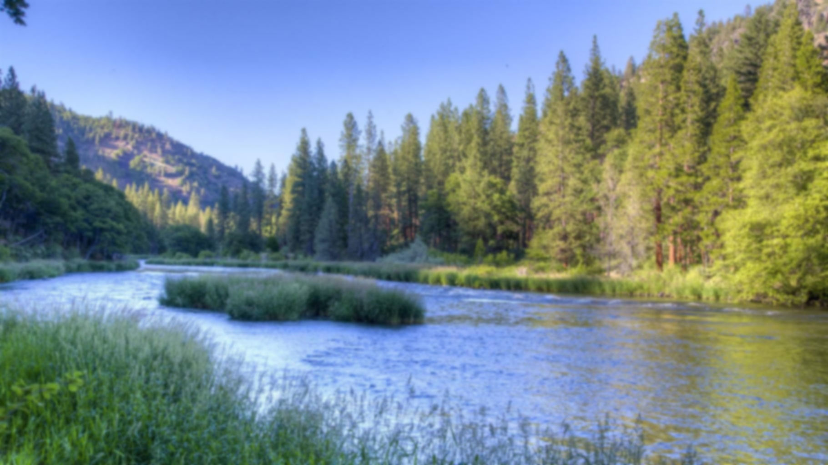
INDIGENOUS HISTORY
Saranoma Crater National Park
Oregon
Cayuse and Paiute Peoples
Cayuse and Paiute were nomadic, never permanently lived in the crater
Came to crater year-round for trout fishing in the glass river
  Agreement to Share the Land
Area not culturally important know the have mystical properties
  Said to take people in the night
  Also brings people back from the dead
  Ghosts
  Ghost Animals

Slide 5
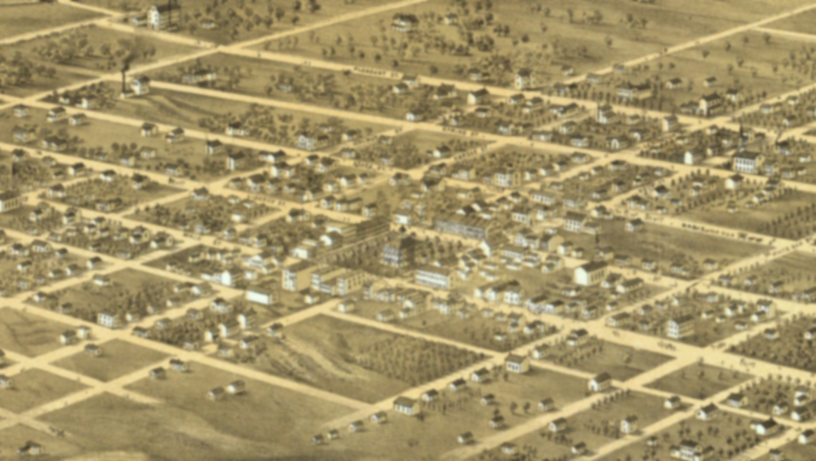
NEILMAN FAMILY
Saranoma Crater National Park
Oregon
The Family
Family was Made up of:
  Joseph Neilman - Husband
  Racheal Neilman - Wife
  Annie Neilman – Eldest Daughter
  Emma Neilman – Middle Daughter
  Francine Neilman – Youngest Daughter
Traveled alone to the west from Independence Missouri in 1834
  This was seen as highly unusual
  Joseph Noted in his diary that he was “…told by god to go alone…”

Slide 6
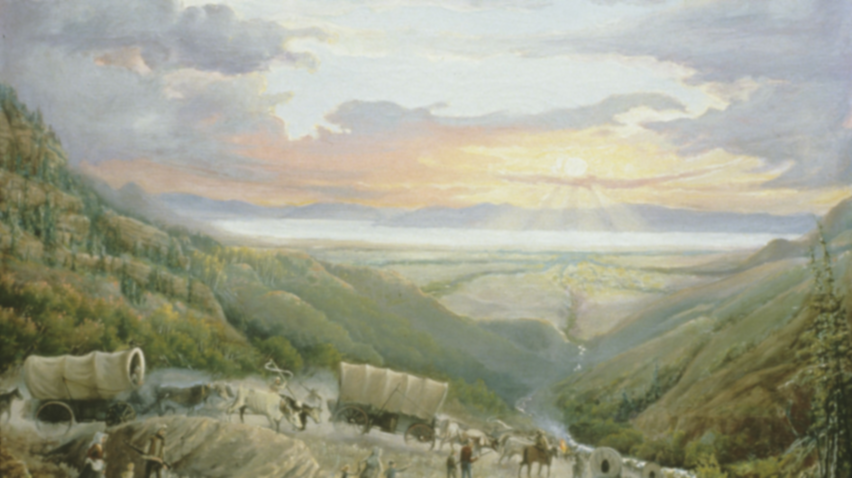
NEILMAN FAMILY
Saranoma Crater National Park
Oregon
The Discovery
Last seen April 15th, 1834, departing from Independence
Family Traveled until they reached lake Luther and thought the crater was a mountain range
  Traveled up Glaciers past and then over around what its now mount Annie, where they realized that the area was a crater
  Joseph Neilman originally referred to the crater as the promised land
Established a small camp in a clearing where Joseph eventually built a small cabin and started a small farm.
Arrived in the summer, but eventually winter came

Slide 7
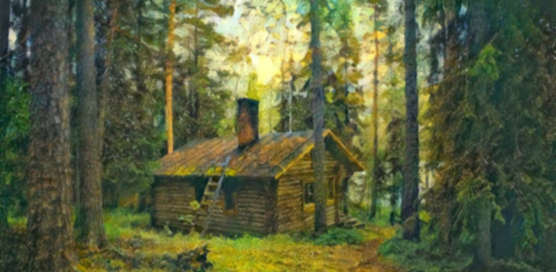
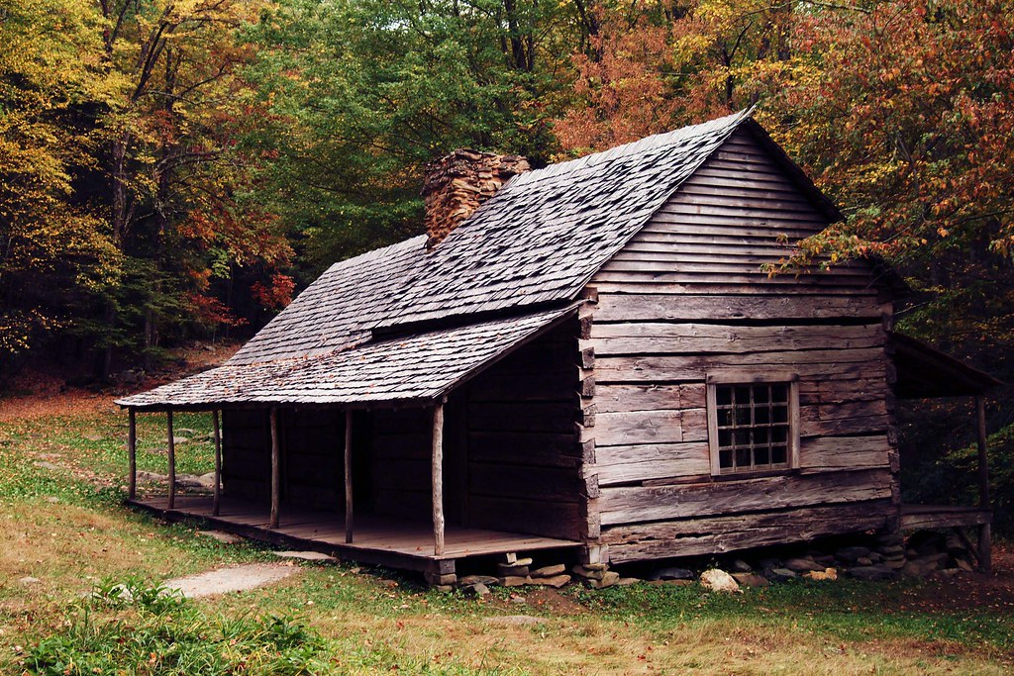
NEILMAN FAMILY
Saranoma Crater National Park
Oregon
Strangeness
Diary was discovered in 1838 by Johansson Sisters
Diary entries began lucid but began to grow more crazed, described strange occurrences
  Lights in forest
  People running across open fields
    Possibly indigenous peoples
  Describes Lights in the Sky
    Shooting stars
  Disappearances
Neilman Cabin in 2019
Notes:
Lights were possibly Indigenous people, but this is disputed because they usually came in the summer
The Lights in the sky have been through to be shooting stars or even possibly a super nova

Slide 8
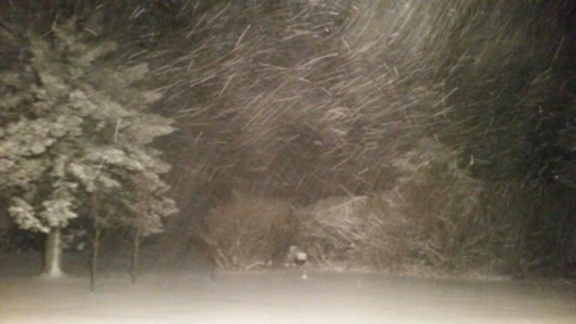
NEILMAN FAMILY
Saranoma Crater National Park
Oregon
The Disappearances
Diary describes disappearances
  Francine disappeared, through to have been exploring caves
  Rachel and Emma went to search and were never seen again
    Remains have been found on Numidea Island
    Unknown why Joseph did not go with them, he does not elaborate
  Annie disappeared in the middle of the night from the house
    Joseph Describes that she “Ran from the voice of god in the dark of night”
  Last entry is on 16th of January, Joseph says “I can finally see the light of god descending from the havens, I shall be rewarded for the work I have done on the mortal plane”
    His body has never been found

Slide 9
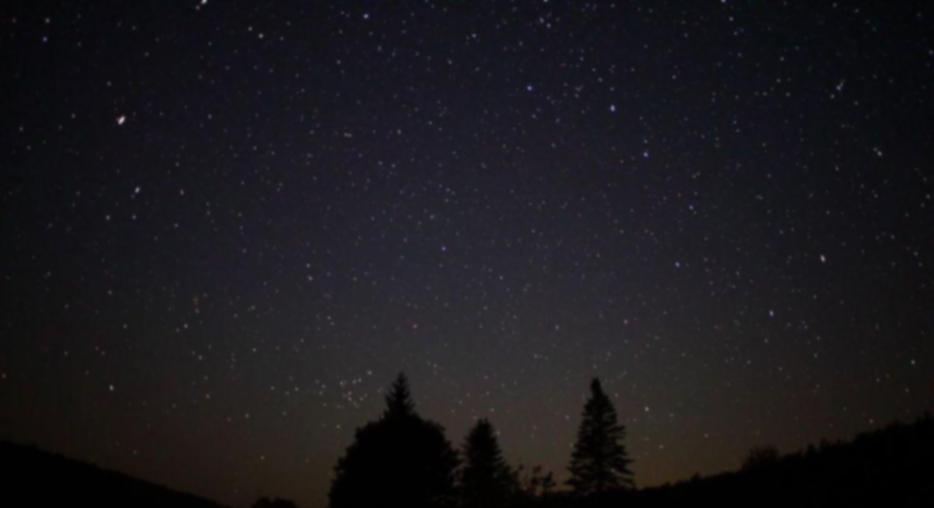
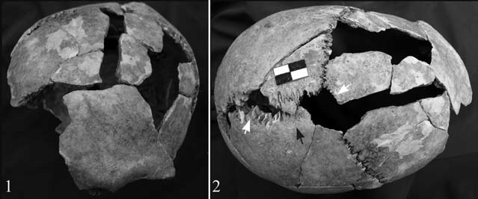
NEILMAN FAMILY
Saranoma Crater National Park
Oregon
Death Hypotheses
Francine Died exploring caves, possibly from a fall, or possibly from starvation after getting lost
Rachel and Emma possible died from falling or a falling branch.
  It is also suspected they were murdered by Joseph as diary describes a debilitating mental state
Annie is suspected to have been killed by Joseph but only for lack of an explanation; true death is unknown
Misconceptions/Unlikely Hypotheses
  Killed by Native Americans
  Aliens
Recovered Skull Fragments of Emma
Notes:
Unlikely to have been killed by Native Americans because
Little to no contact with Native Americans
Cayuse and Paiute Peoples did not travel to the crater during the winter due to the harsh winters
Aliens are extremely unlikely

Slide 10
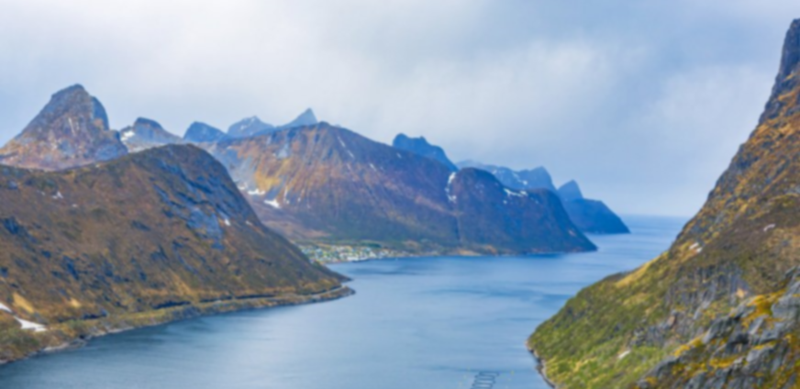
JOHANSSON SISTERS
Saranoma Crater National Park
Oregon
Overview
The Johansson Sisters are commonly referred to as “The Second Lewis and Clark”
  Responsible for documenting much of the Midwest
Immigrants from Norway, running from Christian persecution
Notable Discoveries:
  Documented many of the Colorado Mountain Ranges
  Were some of the first people to encounter tribes in Wyoming, mainly the Shoshone and the Arapaho
  Documented aspects of Yellowstone’s
  Three Sisters Route through the Rocky Mountains (Including the Three Sisters Mountains)
  Documenting the area in an around the Saranoma crater

Slide 11
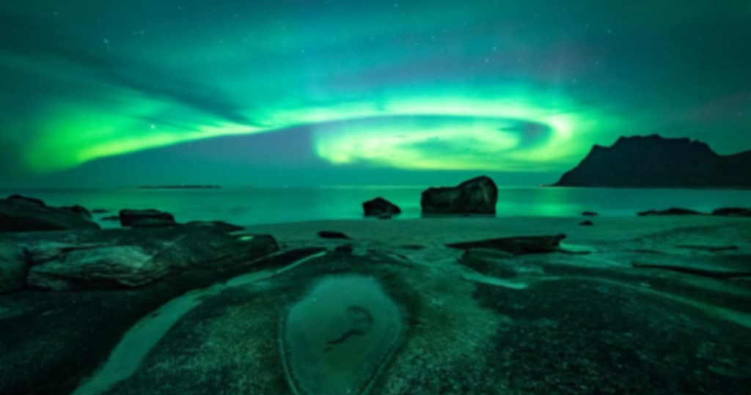
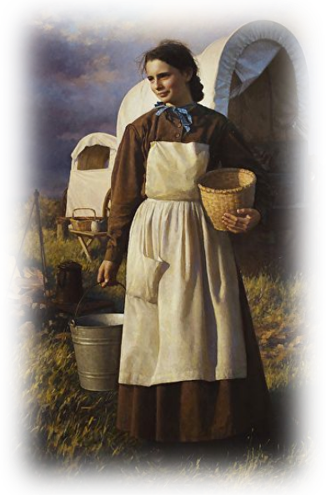
JOHANSSON SISTERS
Saranoma Crater National Park
Oregon
Overview
The sisters are:
  Aud Johansson
    Aud Johansson was 24 at the time of departure from independence with her sister. Aud was known to be an excellent naturalist and geologist.
  Catherine Johansson
    Catherine was 27 at the time of departure. Born Kari Johansson but started to use the name Catherine when she converted to Christianity. She was an impressive linguist.
Aud Johansson in 1840

Slide 12
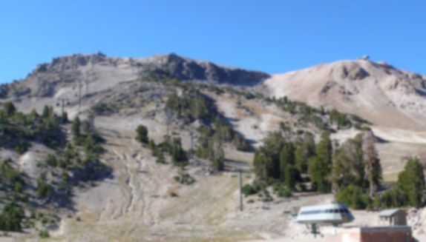
JOHANSSON SISTERS
Saranoma Crater National Park
Oregon
Sisters In Saranoma Crater
Reached the Crater in 1838, where they documented most of the area outside the crater
Later entered the crater through the pass
Discovered Neilman cabin after exploring the crater for 2 months
  Inside found the diary of Joseph
  Were not able to locate Joseph himself
Found Body of Annie at the mid-base of what is now Mount Annie
  Body was in mostly perfect condition, but the sisters recorded that the body was “…perforated with small holes, about 3mm each in diameter, almost exactly 12.3cm apart from each other…”
  Body was buried where she was found
    Body was exhumed in 1975 to study the remains. Body was mostly bones, but bones had evidence of the described perforations

Slide 13
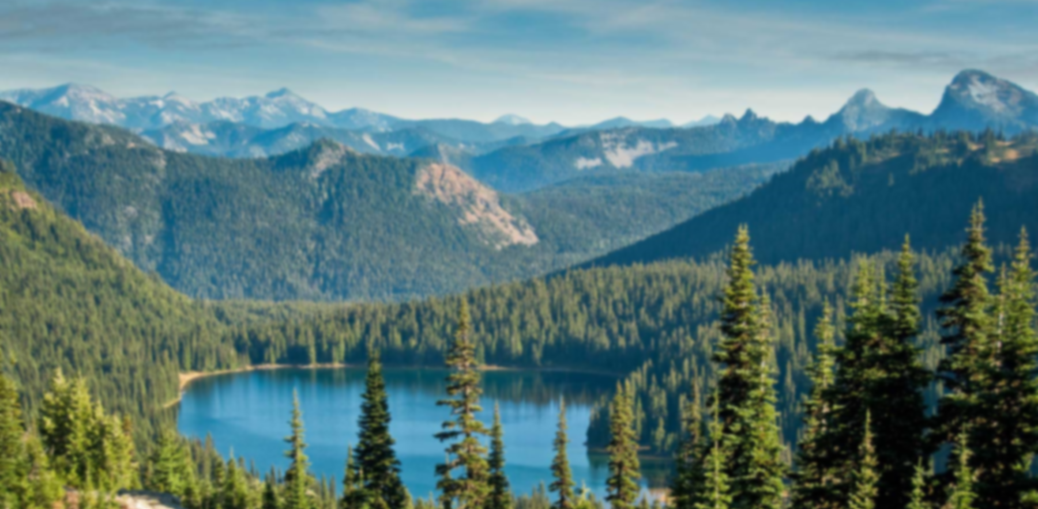
JOHANSSON SISTERS
Saranoma Crater National Park
Oregon
Sisters In Saranoma Crater
Sisters also discovered remains of Rachel and Francine in 1840 on return trip to the crater
Skulls were exhumed in 1975 and it was discovered that their deaths were from head trauma and not hypothermia
Sisters left crater after a number of months and retuned to Missouri
Returned to the crater with close and extended family, along with others to establish a permanent settlement in 1840
Established the settlement that is now St. Catharine

Slide 14
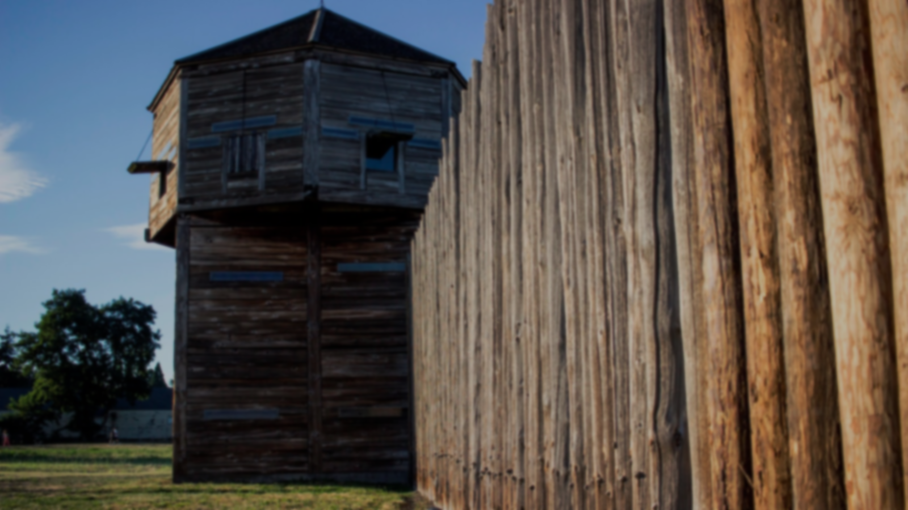
MILITARY PRESENCE
Saranoma Crater National Park
Oregon
Fort Saranoma
Established 1870
Built near Johansson Settlement, against protests from local residents
Fort was built to protect travels on the Oregon trail, as well as the crater
  Highly disputed as the area was known to be relatively safe
Fort would stay garrisoned until 1902 where it was decommissioned and given to the town
Eventually turned into a museum in 1915, part of a grater push to preserve the history of the crater.

Slide 15
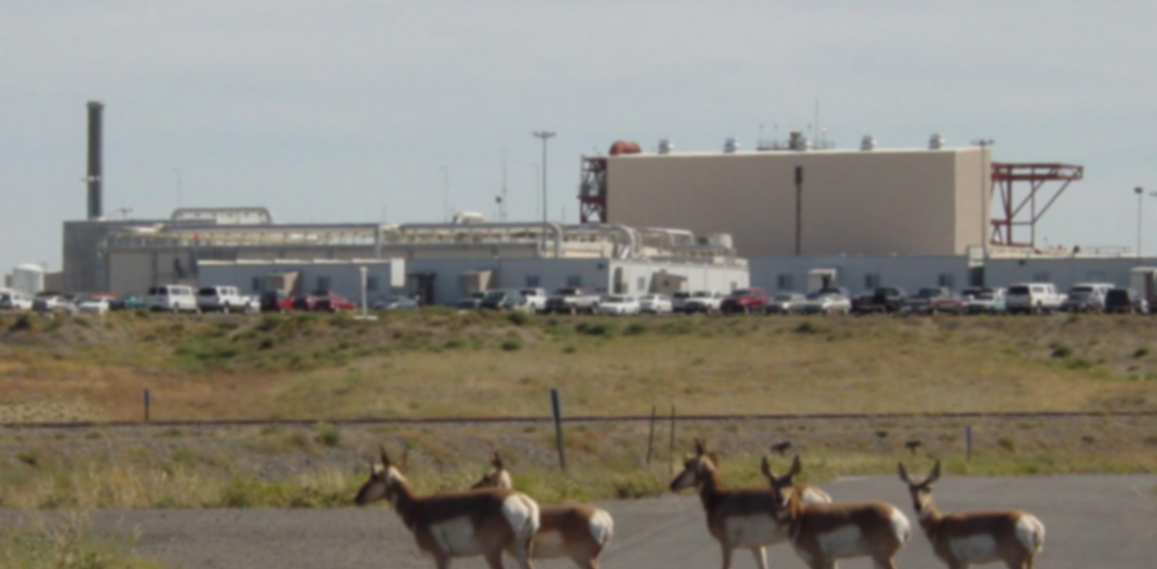
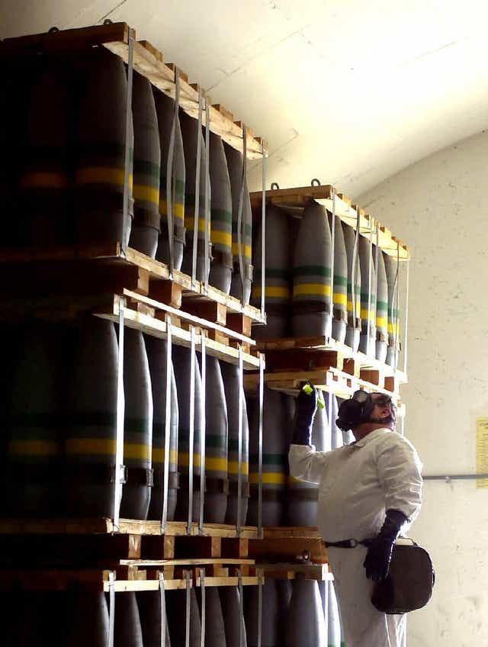
MILITARY PRESENCE
Saranoma Crater National Park
Oregon
Outpost 13
Established 1942 as depot and service junction for supplies coming from the mid-west
Actual purpose was to store chemical weapons, used the extensive cave system below as storage
Called outpost 13 because the cave below were said to be haunted
Post WW2 the depot continued to serve as until the 1975 earthquake
  Earthquake caused damage to tunnels, which posed hazard to chemical weapons
Chemicals were moved to Umatilla Chemical Depot and then disposed of
Chemical Weapons at Umatilla

Slide 16
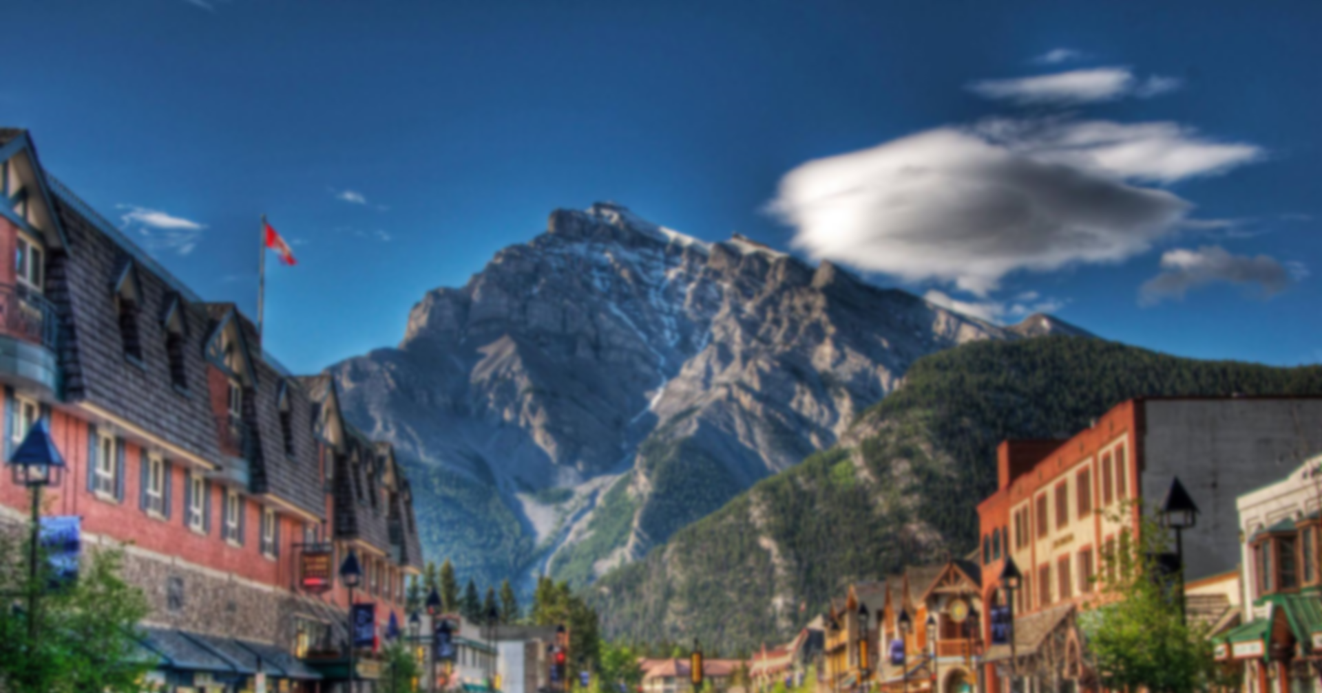
St. CATHARINE'S TOWN
Saranoma Crater National Park
Oregon
Establishment
Following second trip 1840 Johansson's brought the rest of their family along with some others
  Settled in the Crater Hearth, need mount Francine, had good environment for farming
Town originally referred to as “Johansson’s Town” or “Crater Town”
Aud began to refer to the town as St. Catharine's Town as part of a joke
  Poking fun at her Religious piety
Name became more common after Catharine’s death in 1882

Slide 17
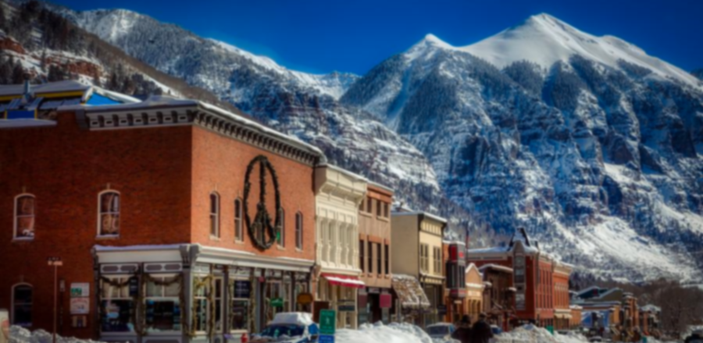
St. CATHARINE'S TOWN
Saranoma Crater National Park
Oregon
Oregon Trail
Town became an important stop on the Oregon trail
  Referred to as the “First stop on the new frontier”
  Had large public building called the Hearth House
Town began to expand, especially after the establishment of fort Saranoma in 1870
Town was officially incorporated in 1890 with a population of 2 ,721

Slide 18
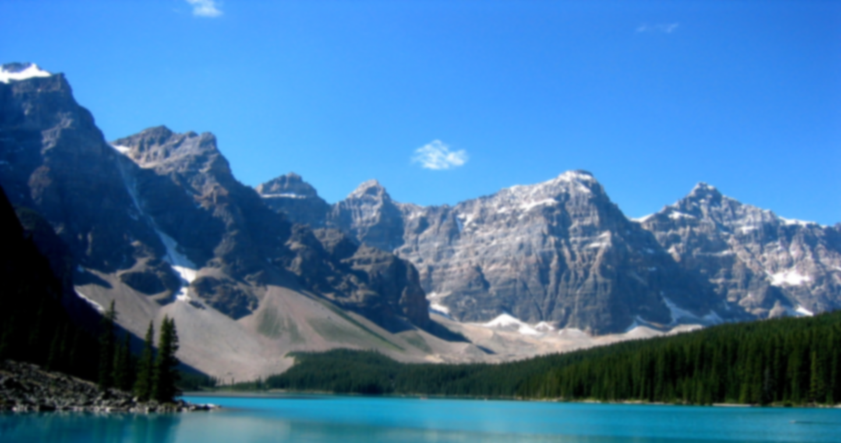
NPS MANAGMENT
Saranoma Crater National Park
Oregon
Park Overview
Park Signed into law by congress in 1921
St. Catharine given land inside the park as well as special authority in the surrounding land
St. Catherine works with NPS to support tourism and conservation
Park includes many parks, the Main Crater, the Crater Basin, the Underground tunnels, the Seats of Mars and the Crater Lowlands

Slide 19
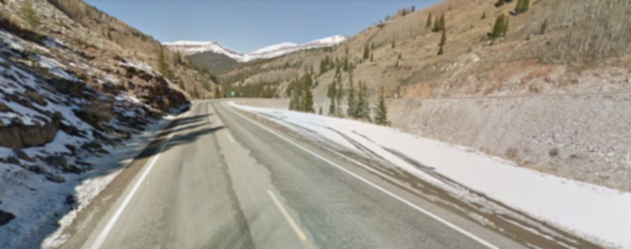
NPS MANAGMENT
Saranoma Crater National Park
Oregon
Main Crater
Inside the crater is usually referred to as the “Hearth”
Has many mountains but only three extinct volcanic mountain Annie, Francine, and Emma. Called the Crater sisters
  Mountains are named after the Neilman sisters
Most wildlife lives in the Hearth but have spread out throughout some of the highlands
Only opening is called caters pass
  Formed after years of erosion from snow, as well as weak rock deposits.

Slide 20
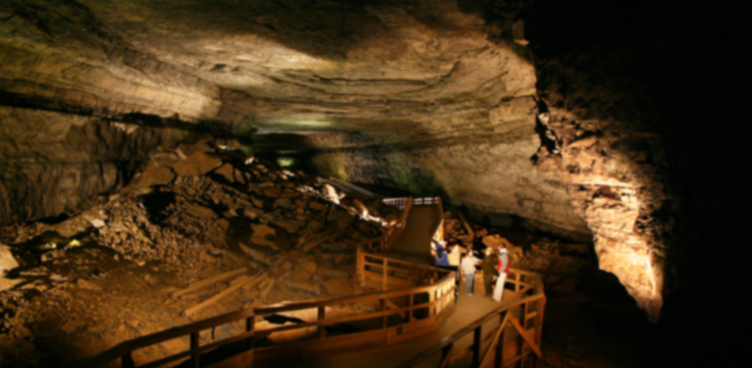
NPS MANAGMENT
Saranoma Crater National Park
Oregon
The Underground
The highlands are filled with underground lava tunnels, possibly from the formation of the highlands and the crater
Most tunnels are connected to the three crater sisters
Tunnel have been partially mapped through exploration, and through using underground penetrating radar
  Tunnels have not been completely explored
Tunnels have resulted in many deaths and disappearances

Slide 21
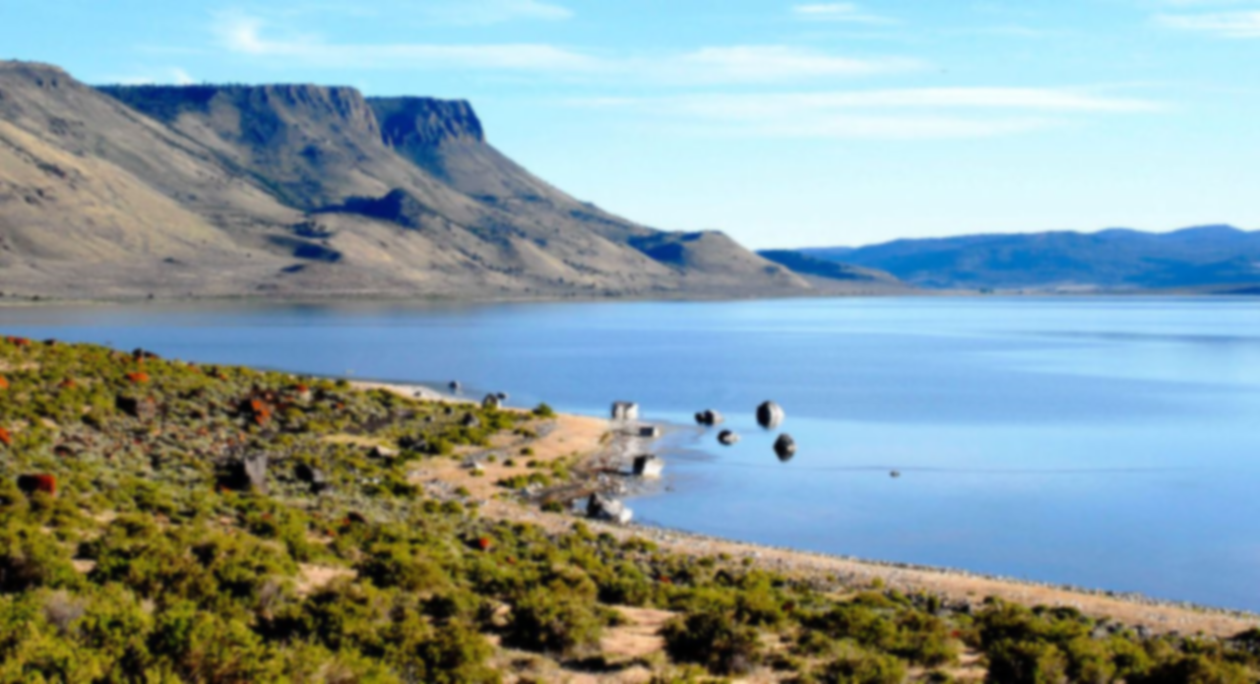
NPS MANAGMENT
Saranoma Crater National Park
Oregon
Crater Basin and Lake Luther
The Crater basin is an area behind the crater and contains a large lake known as lake Luther
Lake Luther is one of the largest lakes Oregon.
Lake is made up of run off from the mount Annie and eastern glaciers
Popular boating location

Slide 22
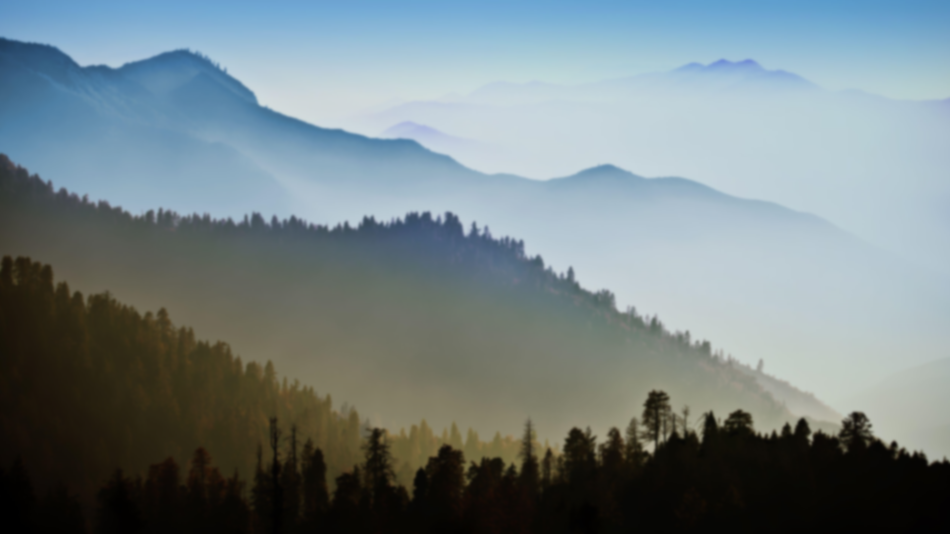
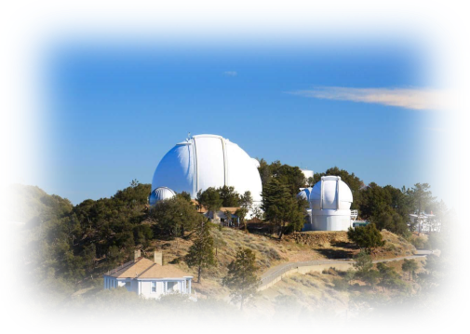
NPS MANAGMENT
Saranoma Crater National Park
Oregon
Seats of Mars
Largest concentration of hills in the Saranoma Highlands
Famous for their view of the night sky
Named by Ida Johansson, daughter of Catherine
  Ida was and accomplished astronomer
  Made many discoveries including the location of Alpha Centauri years before official discovery
Astronomical Observatory build in 1975 after earthquake, the area was chosen years before by Ida
Ida Johansson Observatory

Slide 23
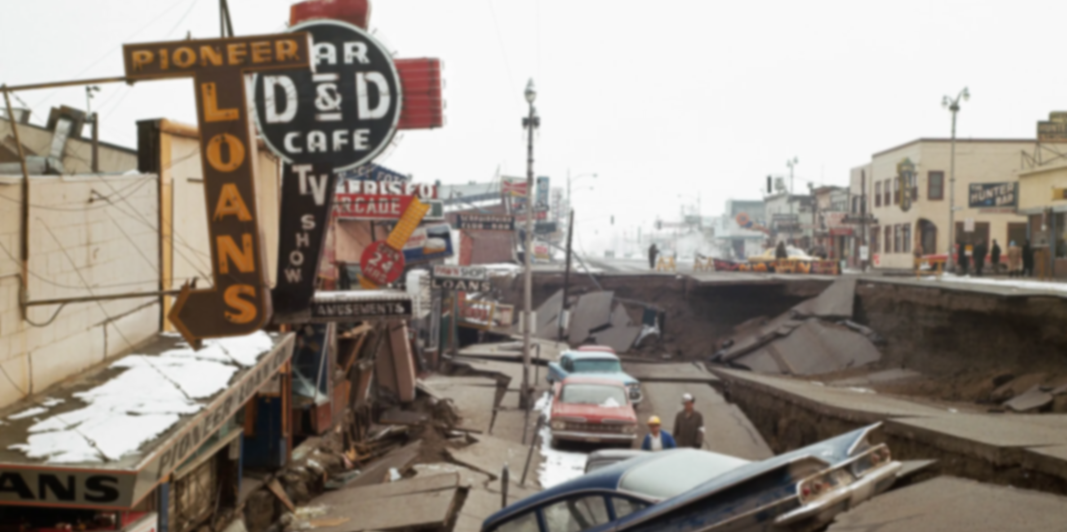
NPS MANAGMENT
Saranoma Crater National Park
Oregon
1975 Earthquake
January 16th, 1975, 6.6 Magnitude Earthquake occurred
Unknown why or how this happened, seems to confirm theory about the anomaly in the earth’s crust
Caused extensive damage to park infrastructure as well as St. Catharine’s Town
23 People died, 712 people suffered major injuries
No aftershocks occurred
Notes:
The fact that there were no aftershocks was seen as extremely odd, the whole earthquake is shrouded in mystery

Slide 24
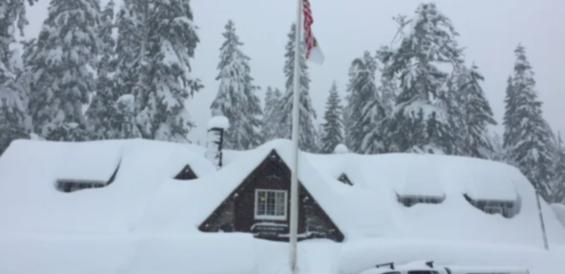
PRESENT DAY
Saranoma Crater National Park
Oregon
Saranoma Crater Today
Park has continued to operate for over 100 years
Average of 750,00 visitors a year
  Visitation wavers during the COVID-19 Pandemic
Contains resorts and inter-park hotels
Museums provide information about parks history
St. Catherine is a hub of tourist attractions and activities
Notes:
The fact that there were no aftershocks was seen as extremely odd, the whole earthquake is shrouded in mystery

Slide 25

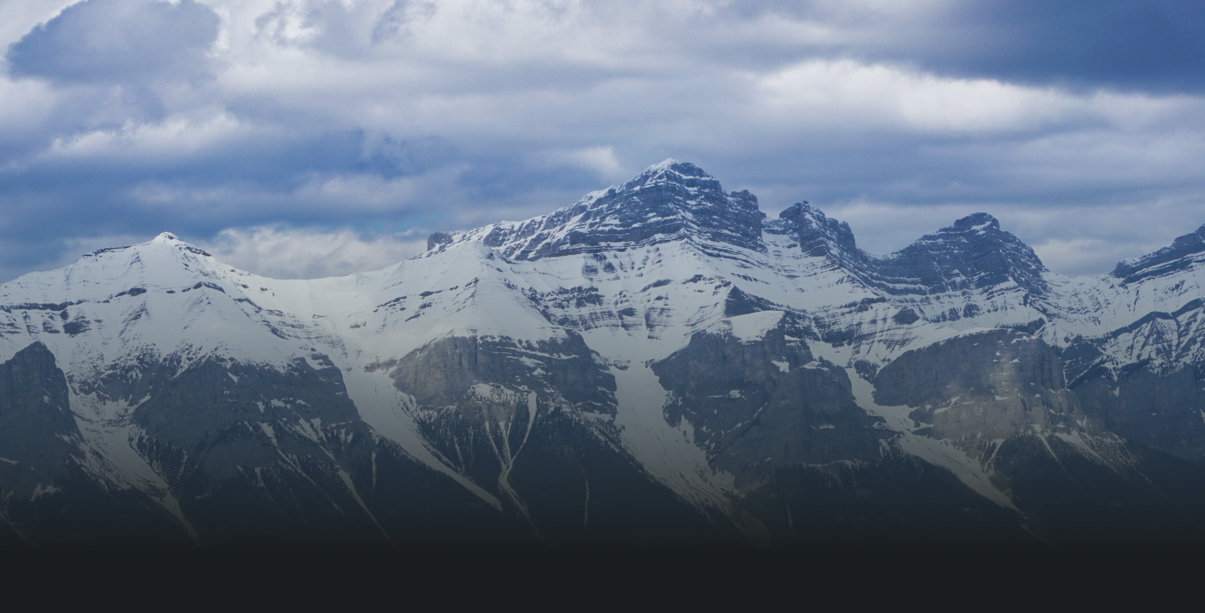
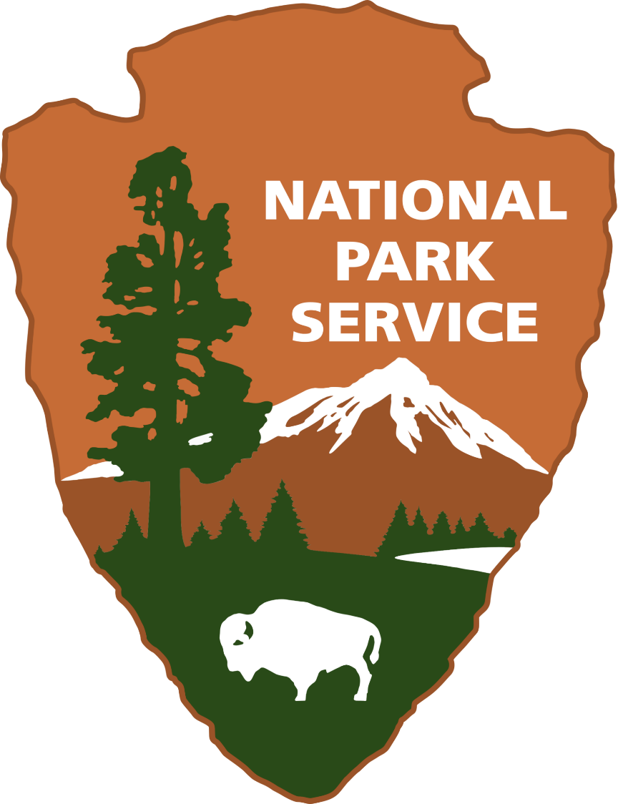
THE END
Saranoma Crater National Park
Oregon
Please enjoy exploring your public lands!

